Slide 1
Datacenter Modernization from Hyper-V to Hyper-Converged Infrastructure
Elden Christensen
EldenC@Microsoft.Com
Principal PM Manager

Slide 2
Hyper-Converged Infrastructure Market Opportunity
Storage Spaces Direct 10 Ways It’s Better in WS 2019
Software Defined Networking Network Controller and Gateway
RDMA
Cluster Sets Scaling Out
Agenda

Slide 3
+65%
HCI Adoption YoY
$5B
Market Size
In 2017
By 2019
IDC Worldwide Quarterly Converged Systems Tracker, Q1 2017
https://thestack.com/data-centre/2017/06/26/hyperconverged-market-grows-64-over-2016/
Gartner Press Release
https://www.gartner.com/newsroom/id/3308017

Slide 4
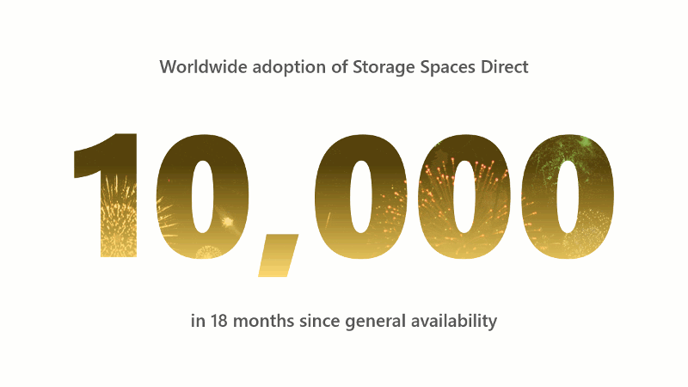
Worldwide adoption of Storage Spaces Direct
clusters in 18 months since general availability

Slide 5
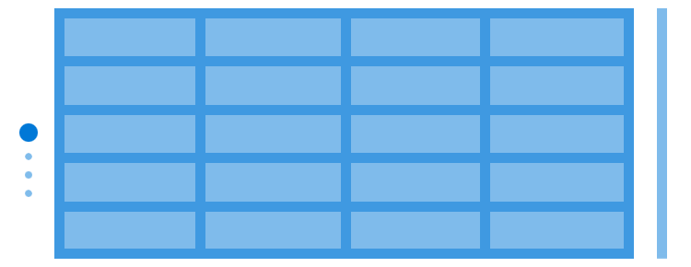
Ethernet Switches
Misc. Appliances
Ethernet Switches
Hypervisors
Standard x86 servers
+
Local drives
+
The magic of software
Storage Fabric
Storage (SAN)
Legacy “Three Tier” Infrastructure
Hyper-Converged Infrastructure (HCI)

Slide 6
Ethernet Switches
Misc. Appliances
Ethernet Switches
Hypervisors
Standard x86 servers
+
Local drives
+
The magic of software
Storage Fabric
Storage (SAN)
Legacy “Three Tier” Infrastructure
Hyper-Converged Infrastructure (HCI)

Slide 7
Hyper-V
Storage Spaces Direct
SDN
New in Windows Server 2016
In development for 5+ years at Microsoft
Foundation of Azure Stack
Introduced in 2008, ten years ago!
Foundation of our hyperscale Azure cloud
New in Windows Server 2016
Taken directly from Azure

Slide 8
Two options to procure, both supported
1
Build Your Own
2
Partner Solutions

Slide 9
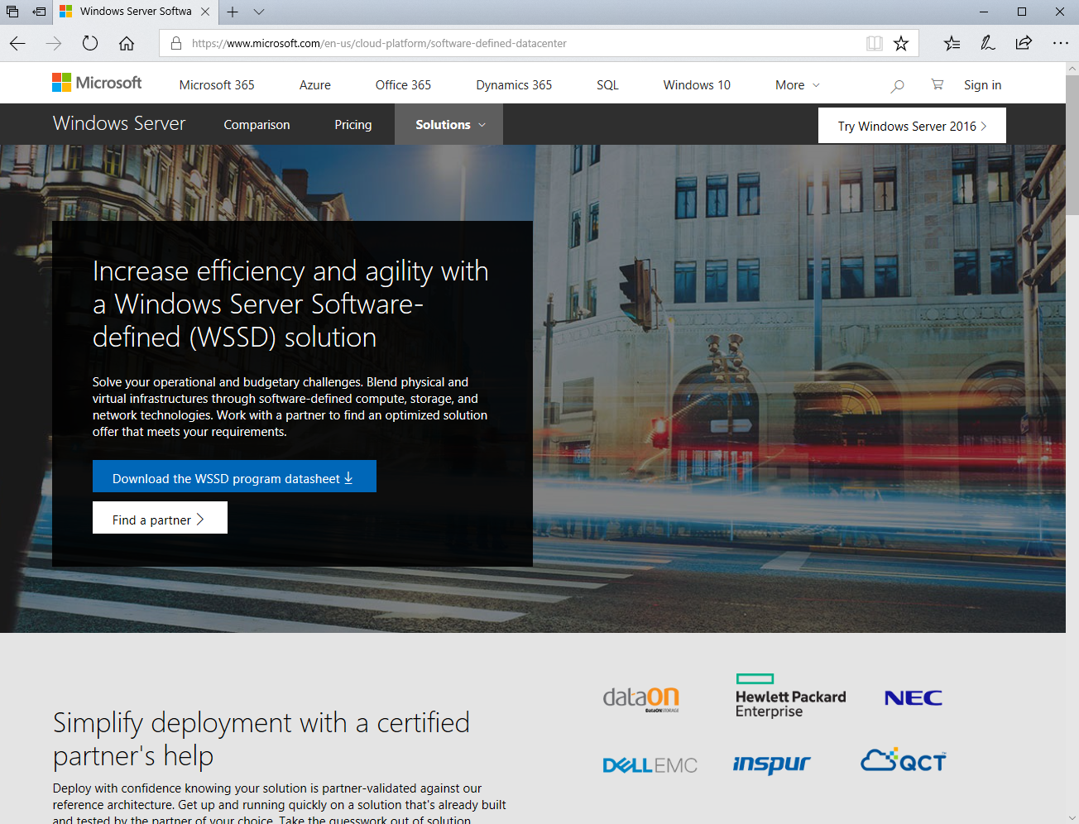
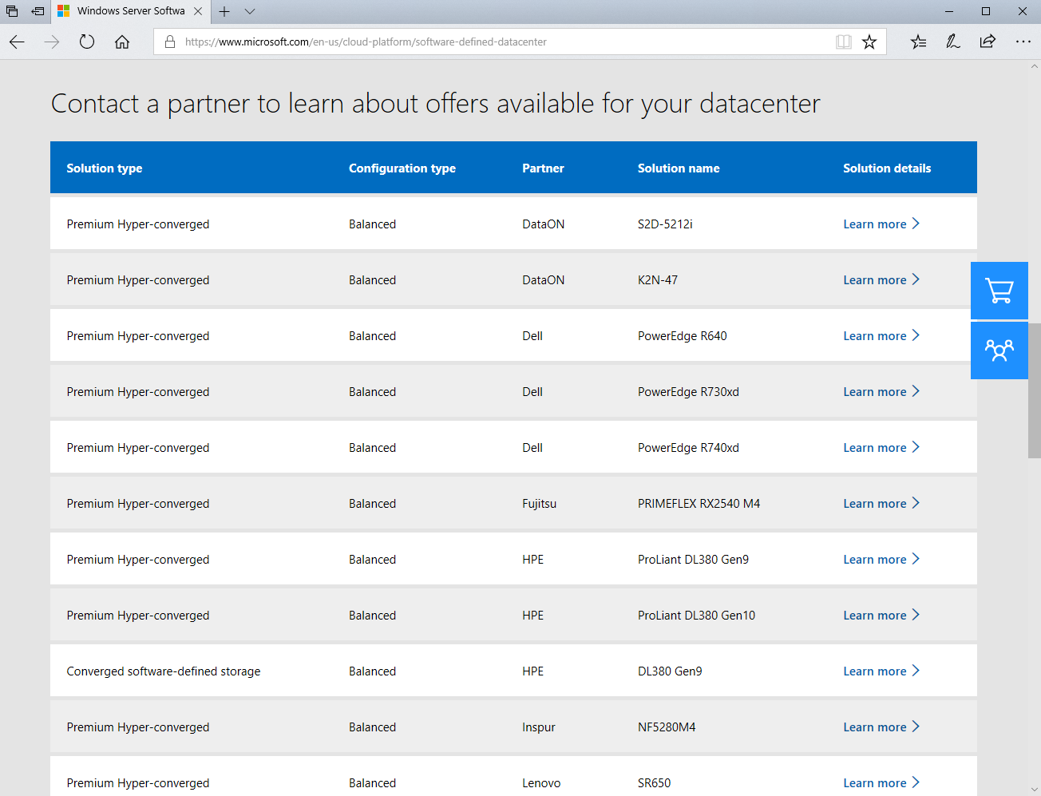
Learn more at microsoft.com/wssd

Slide 10
Why is Windows Server better than [competitor] ?

Slide 11
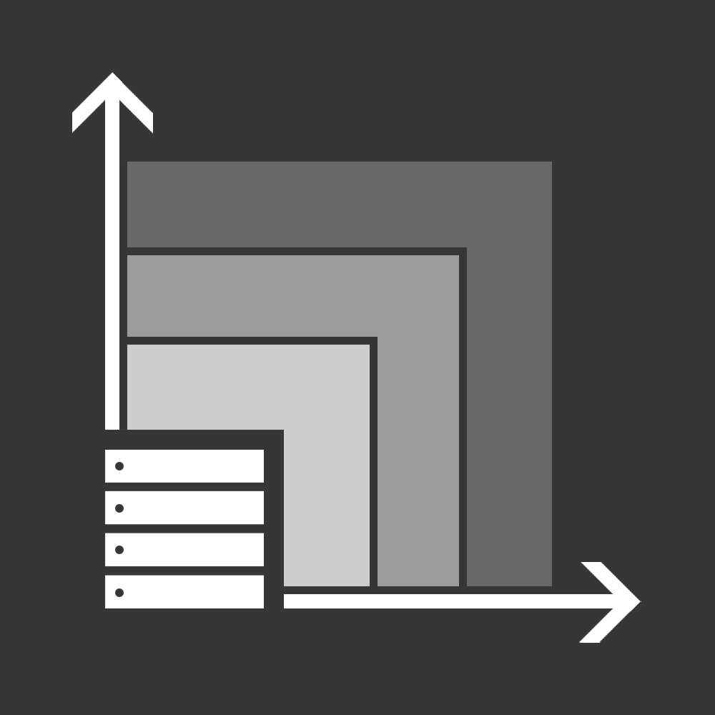
Hyper-converged infrastructure has many advantages
Lower costs
Innovate faster
Simple scalability and expansion
Single vendor
Unified management
No proprietary hardware or vendor lock-in
Choice of industry-standard servers and components
Reduce datacenter footprint and power and cooling cost
100x more servers sold every year than storage arrays
Inflection point in hardware, from NVMe to RDMA
Innovations come to Windows Server first
Buy what you need today, reduce Cap Ex
Scale by adding servers, one by one
Cloud-inspired architecture enables near-limitless scale
Built-in balancing makes planning easy
Single source for procurement and support
Pre-validated, no integration work
With Windows, no separate licenses, and included guests!
End-to-end visibility across the whole stack
Consistent, unified experience across compute, networking, storage
Reduce Op Ex

Slide 12
Advantages of Hyper-Converged Infrastructure on Windows
Lower costs
Innovate faster
Simple scalability and expansion
Single vendor
Unified management
No proprietary hardware or vendor lock-in
Choice of industry-standard servers and components
Reduce datacenter footprint and power and cooling cost
100x more servers sold every year than storage arrays
Inflection point in hardware, from NVMe to RDMA
Innovations come to Windows Server first
Buy what you need today, reduce Cap Ex
Scale by adding servers, one by one
Cloud-inspired architecture enables near-limitless scale
Built-in balancing makes planning easy
Single source for procurement and support
Pre-validated, no integration work
With Windows, no separate licenses, and included guests!
End-to-end visibility across the whole stack
Consistent, unified experience across compute, networking, storage
Reduce Op Ex

Slide 13
Included in Windows Server Datacenter
Hypervisor / compute
Software-defined storage
Software-defined networking
Management software
Unlimited guest licenses
Source: https://www.microsoft.com/en-us/cloud-platform/windows-server-pricing

Slide 14
Advantages of Hyper-Converged Infrastructure on Windows
Lower costs
Innovate faster
Simple scalability and expansion
Single vendor
Unified management
No proprietary hardware or vendor lock-in
Choice of industry-standard servers and components
Reduce datacenter footprint and power and cooling cost
100x more servers sold every year than storage arrays
Inflection point in hardware, from NVMe to RDMA
Innovations come to Windows Server first
Buy what you need today, reduce Cap Ex
Scale by adding servers, one by one
Cloud-inspired architecture enables near-limitless scale
Built-in balancing makes planning easy
Single source for procurement and support
Pre-validated, no integration work
With Windows, no separate licenses, and included guests!
End-to-end visibility across the whole stack
Consistent, unified experience across compute, networking, storage
Reduce Op Ex

Slide 15
Advantages of Hyper-Converged Infrastructure on Windows
Lower costs
Innovate faster
Simple scalability and expansion
Single vendor
Unified management
No proprietary hardware or vendor lock-in
Choice of industry-standard servers and components
Reduce datacenter footprint and power and cooling cost
100x more servers sold every year than storage arrays
Inflection point in hardware, from NVMe to RDMA
Innovations come to Windows Server first
Buy what you need today, reduce Cap Ex
Scale by adding servers, one by one
Cloud-inspired architecture enables near-limitless scale
Built-in balancing makes planning easy
Single source for procurement and support
Pre-validated, no integration work
With Windows, no separate licenses, and included guests!
End-to-end visibility across the whole stack
Consistent, unified experience across compute, networking, storage
Reduce Op Ex

Slide 16
Windows Server HCI is on the leading edge
Persistent memory
Intel Xeon® Scalable®
NVMe
Available to Windows Insiders,
in Windows Server 2019
Supported since announcement on Windows Server 2016
Fully supported M.2, U.2, Add-In-Card (AIC)
OPTANE™
3D XPoint
RDMA
Intel Thunderbolt™ 3
Supported since announcement on Windows Server 2016
Unique to Windows software-defined storage
Blazing the trail for switchless networking
of x86 hardware innovation

Slide 17
Advantages of Hyper-Converged Infrastructure on Windows
Lower costs
Innovate faster
Simple scalability and expansion
Single vendor
Unified management
No proprietary hardware or vendor lock-in
Choice of industry-standard servers and components
Reduce datacenter footprint and power and cooling cost
100x more servers sold every year than storage arrays
Inflection point in hardware, from NVMe to RDMA
Innovations come to Windows Server first
Buy what you need today, reduce Cap Ex
Scale by adding servers, one by one
Cloud-inspired architecture enables near-limitless scale
Built-in balancing makes planning easy
Single source for procurement and support
Pre-validated, no integration work
With Windows, no separate licenses, and included guests!
End-to-end visibility across the whole stack
Consistent, unified experience across compute, networking, storage
Reduce Op Ex

Slide 18
Advantages of Hyper-Converged Infrastructure on Windows
Lower costs
Innovate faster
Simple scalability and expansion
Single vendor
Unified management
No proprietary hardware or vendor lock-in
Choice of industry-standard servers and components
Reduce datacenter footprint and power and cooling cost
100x more servers sold every year than storage arrays
Inflection point in hardware, from NVMe to RDMA
Innovations come to Windows Server first
Buy what you need today, reduce Cap Ex
Scale by adding servers, one by one
Cloud-inspired architecture enables near-limitless scale
Built-in balancing makes planning easy
Single source for procurement and support
Pre-validated, no integration work
With Windows, no separate licenses, and included guests!
End-to-end visibility across the whole stack
Consistent, unified experience across compute, networking, storage
Reduce Op Ex

Slide 19
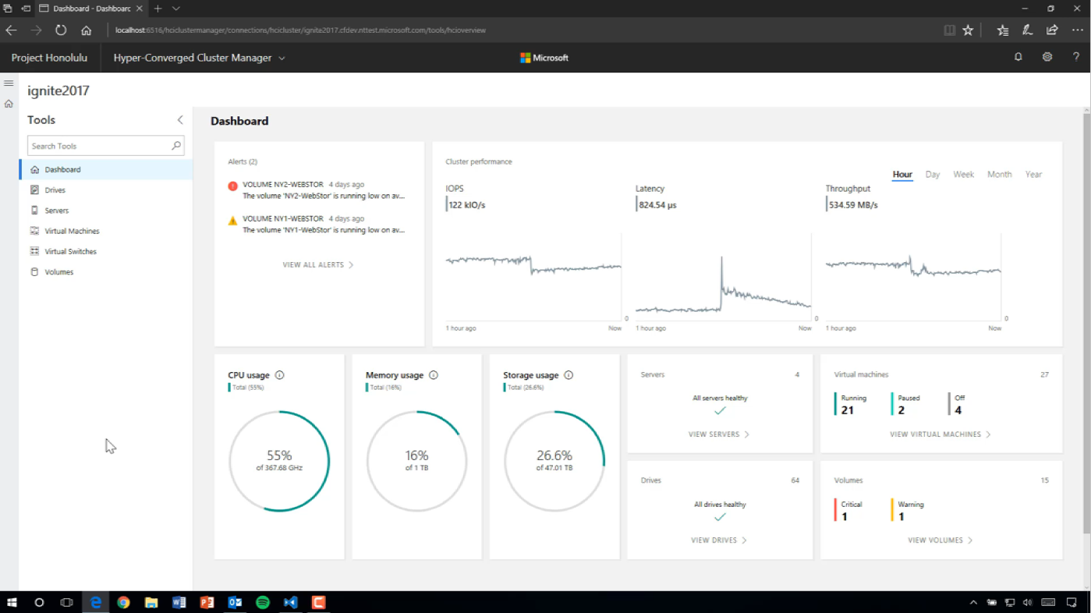
Windows Admin Center
announced at Microsoft Ignite 2017

Slide 20
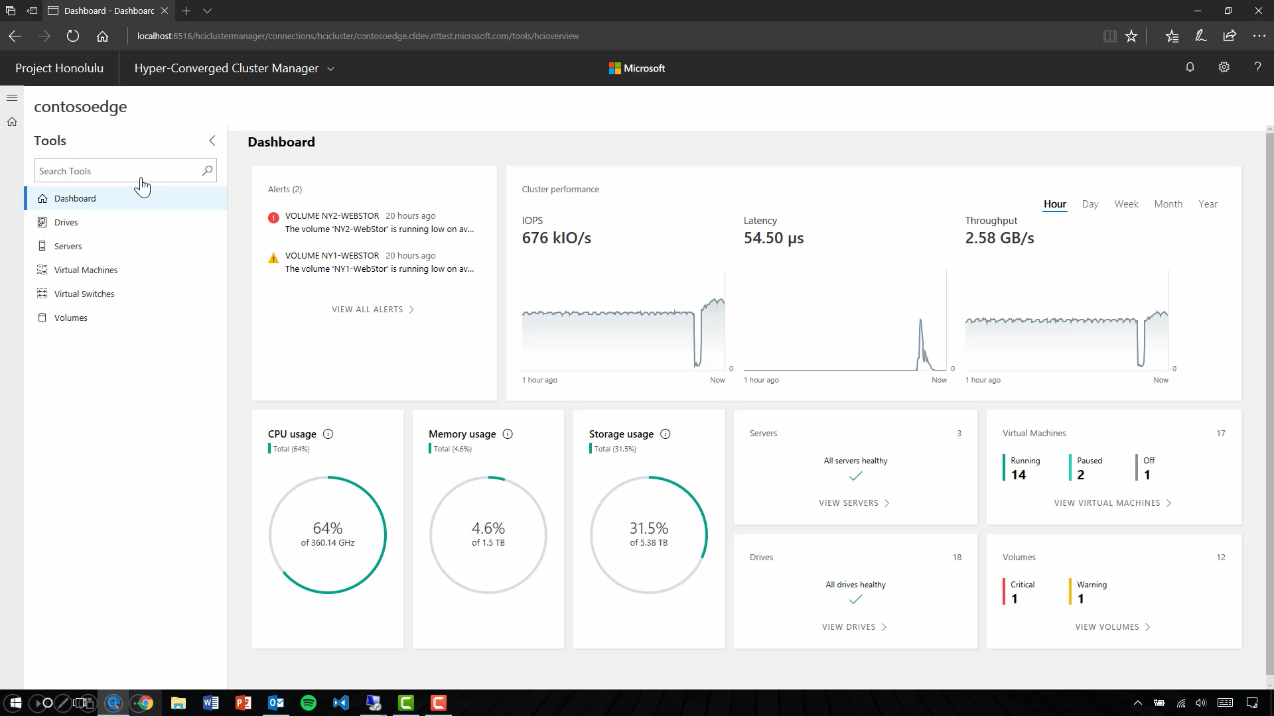
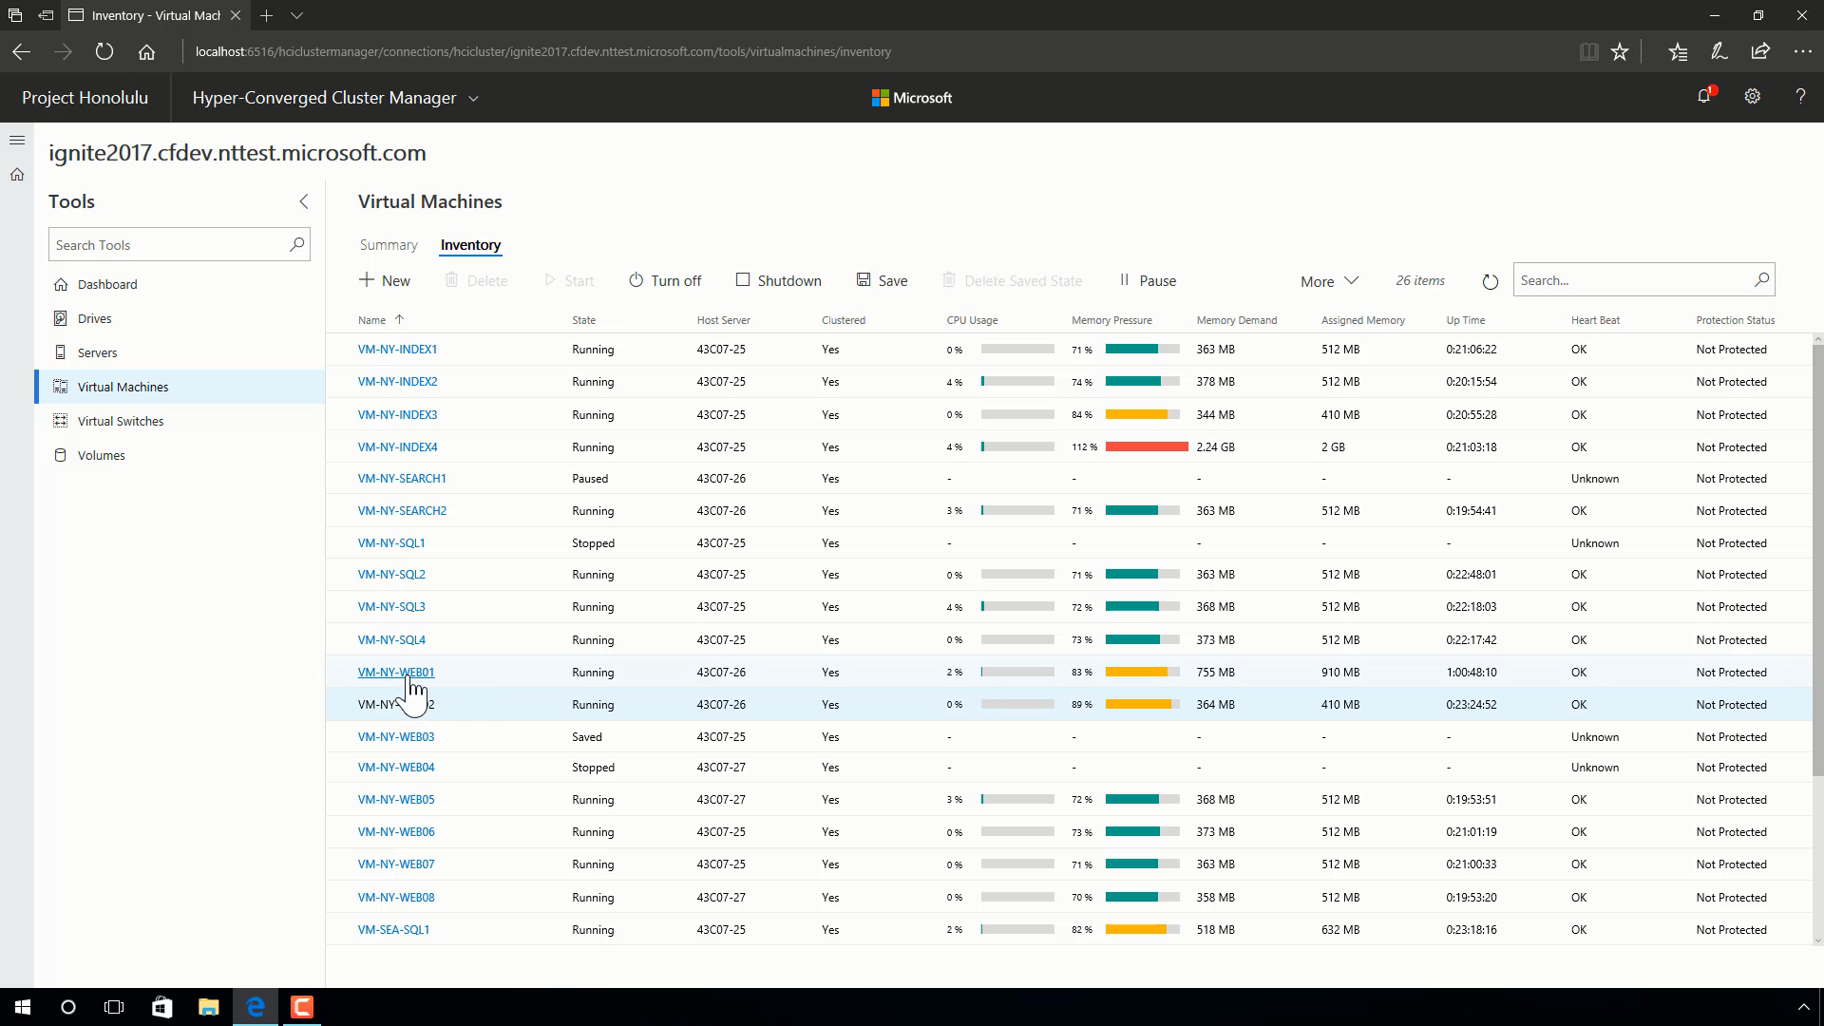
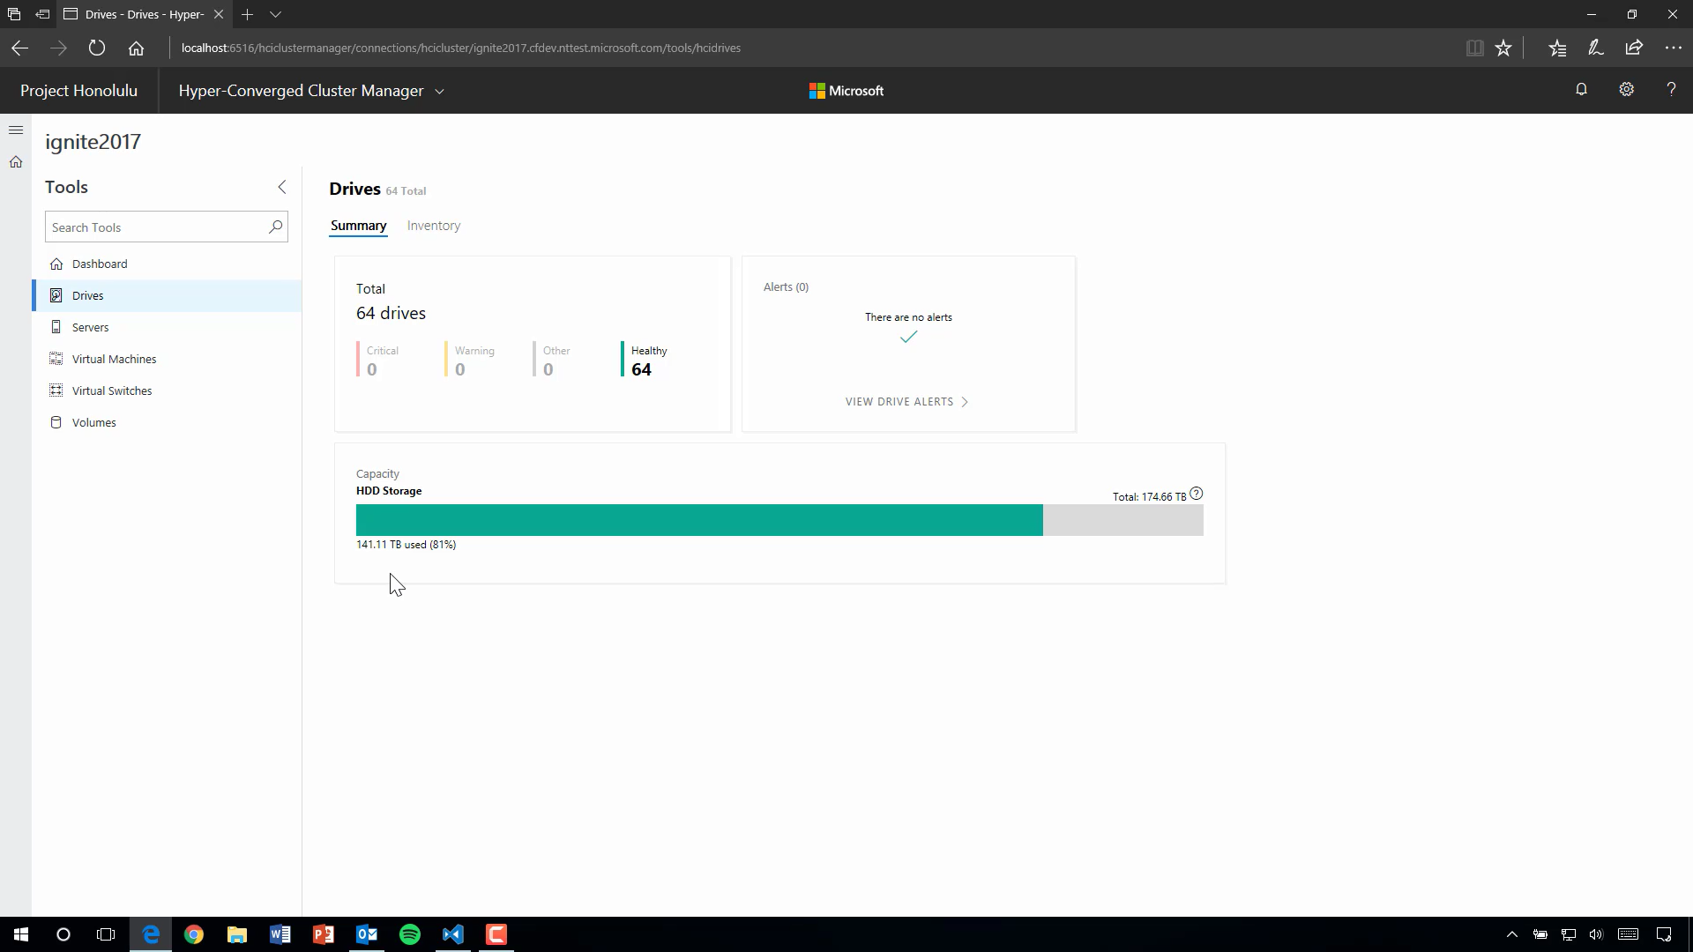
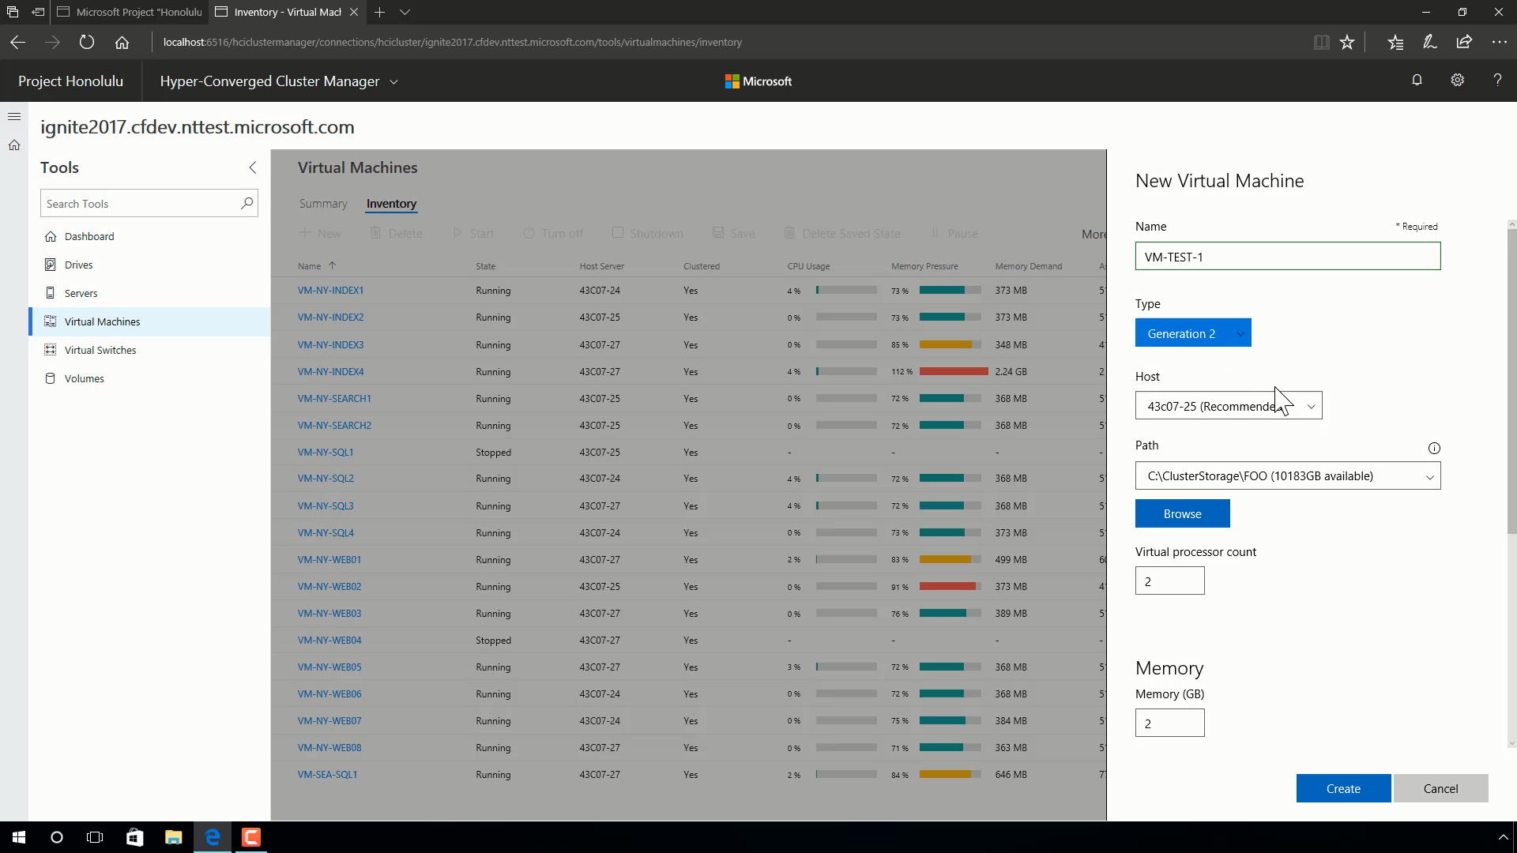
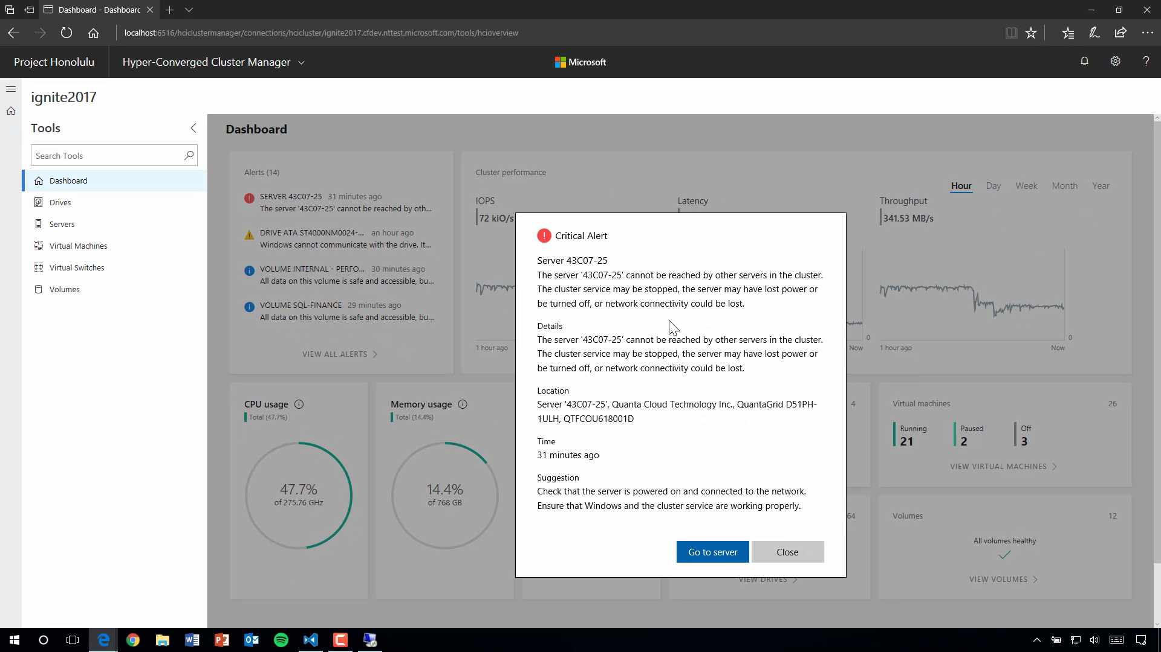
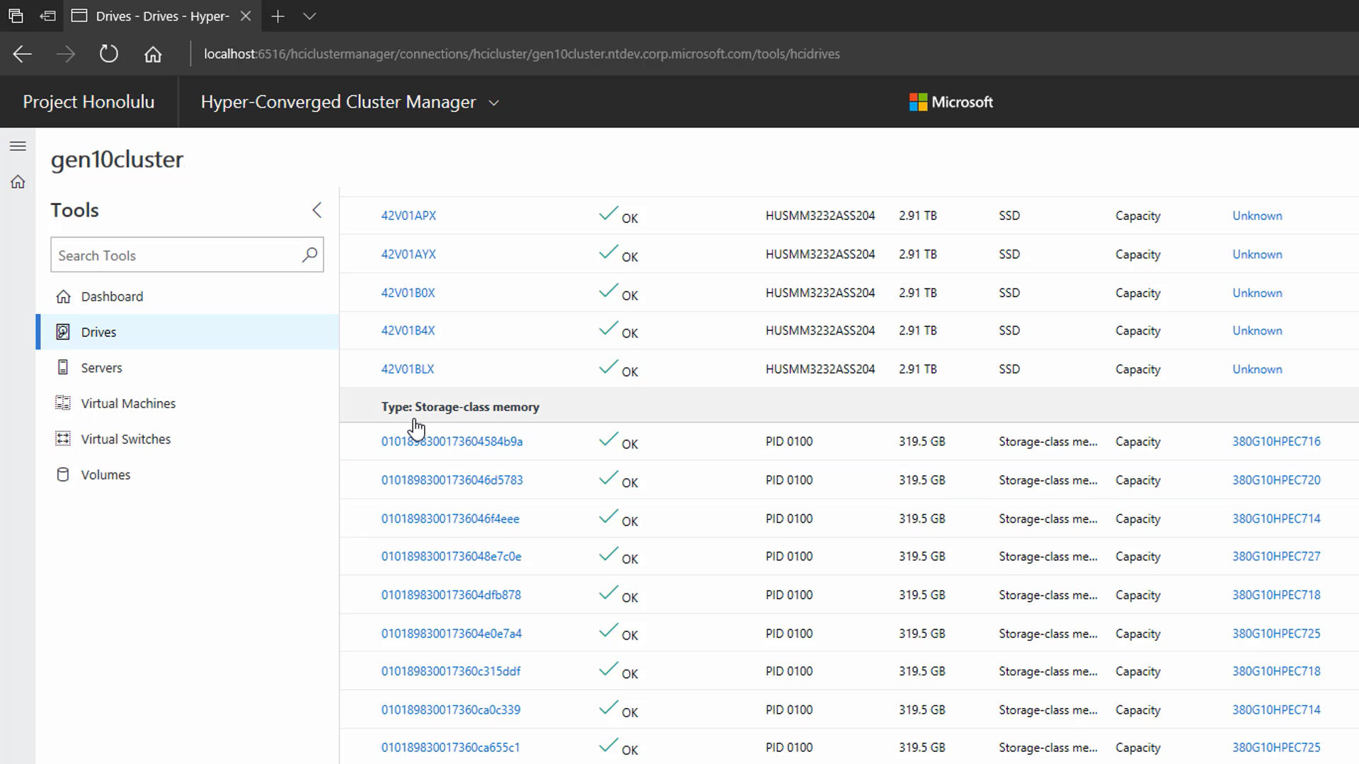
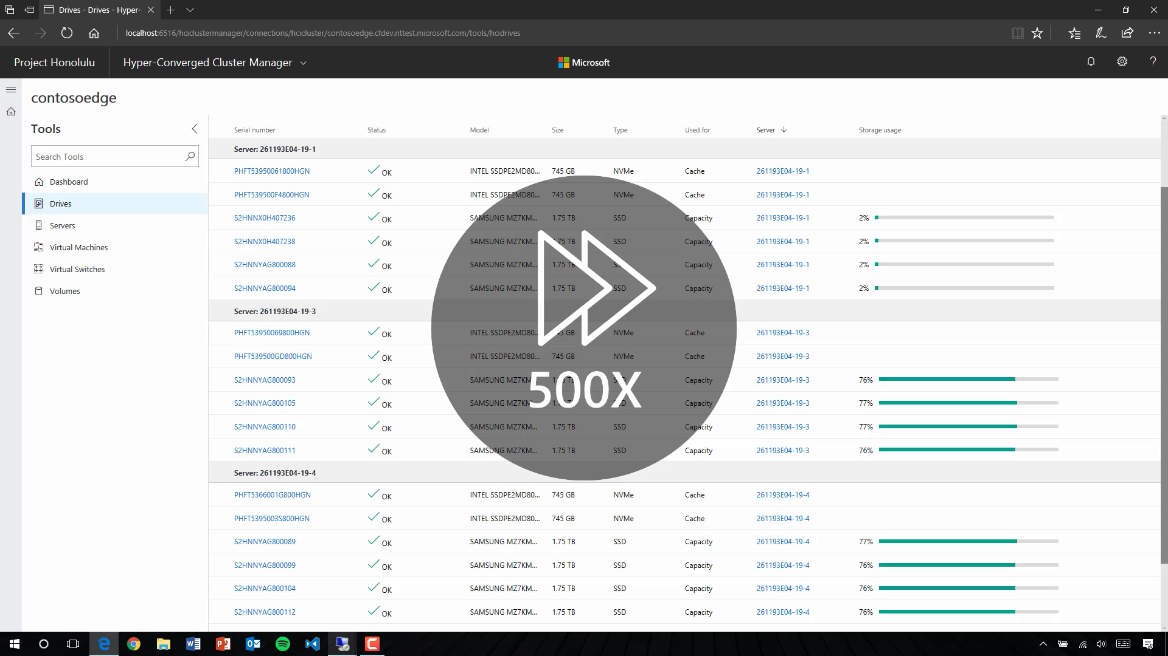
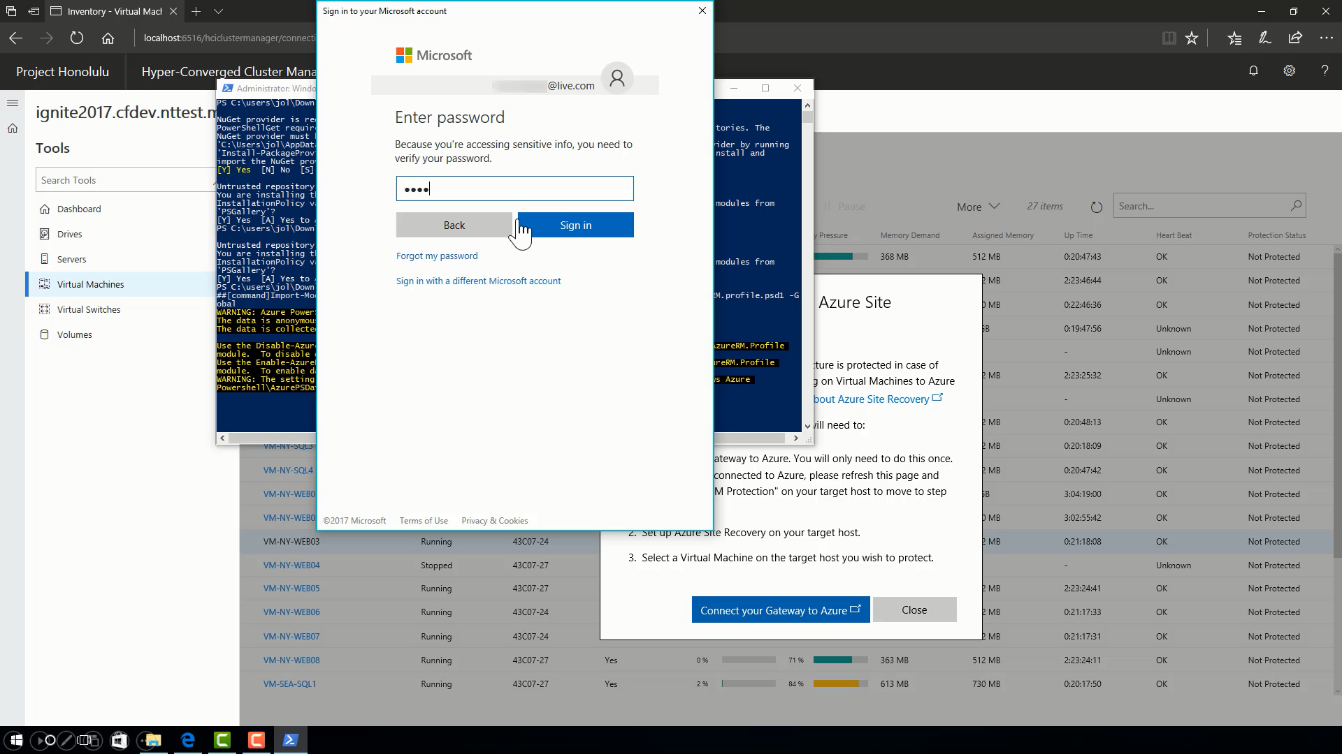
Install project 'Honolulu’ in under 2 minutes
New dashboard for Hyper-Converged Infrastructure
Hyper-V management
Storage Spaces management
Create virtual machine
Alerts and tolerating multiple failures
Storage class memory teaser
Scale out with self-balancing compute and storage
Deduplication and compression
Prepare for the worst with Azure Site Recovery

Slide 21
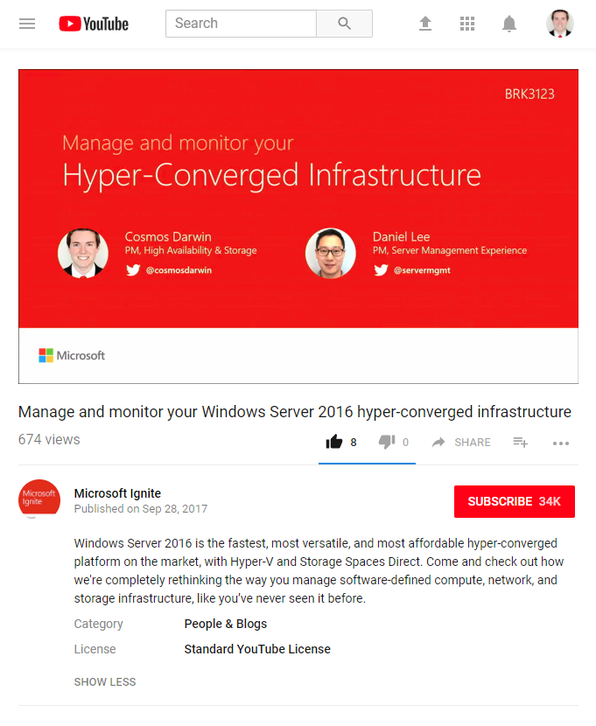
Watch the recording
Manage and monitor your Windows Server 2016 hyper-converged infrastructure - BRK3123
youtube.com/watch?v=CkZgq5RuJHs&

Slide 22
FAQs – Windows Admin Center for HCI
Q: How long does it take to download and install?
A: Under 5 minutes.
Q: Does it cost money?
A: No.
Q: Does it require System Center?
A: No.
Q: Does it require an Internet connection?
A: No.

Slide 23
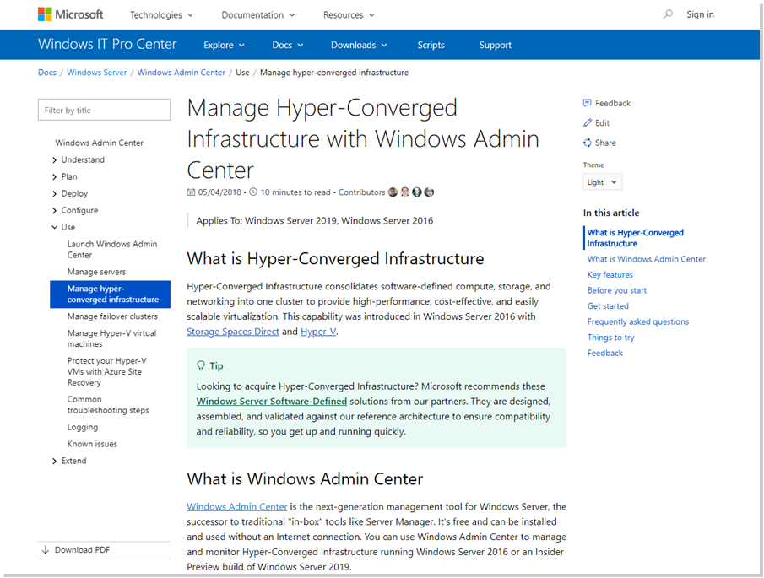
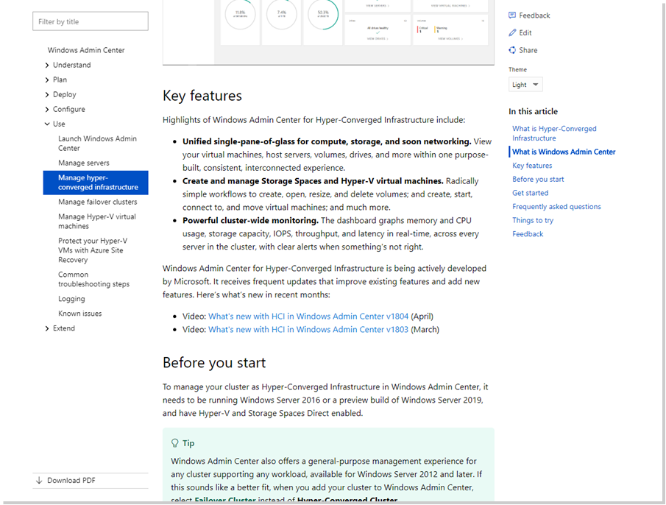
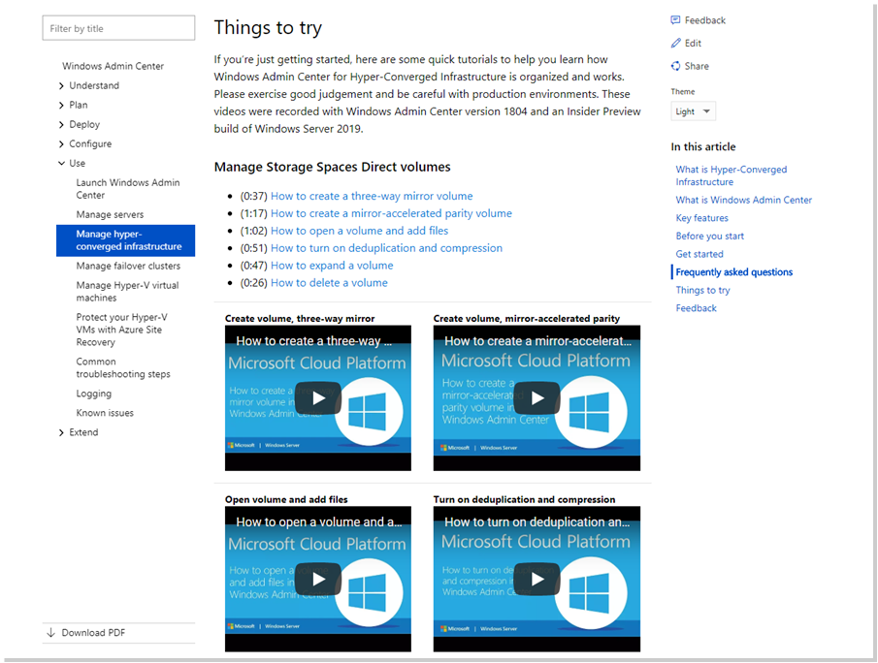
aka.ms/StorageSpacesDirect > Manage in Windows Admin Center

Slide 24
Windows Server offers the fastest, most affordable, and (soon) most easily managed path to Hyper-Converged Infrastructure.

Slide 25
Hyper-Converged Infrastructure Market Opportunity
Storage Spaces Direct 10 Ways It’s Better in WS 2019
Software Defined Networking Network Controller and Gateway
RDMA
Cluster Sets Scaling Out
Agenda

Slide 26
– 1 –
Relaxed hardware requirements

Slide 27
Hardware requirements
Windows Server
Windows Server
Applies to both versions
2016
2019
DWPD
& TBW
Mix-and-match
Drives of different models and sizes for replacement or expansion
Less cache
As low as 5% at large scale or with very high endurance
Less endurance
Recommended 3+ DWPD or 4+ TBW for cache drives

Slide 28
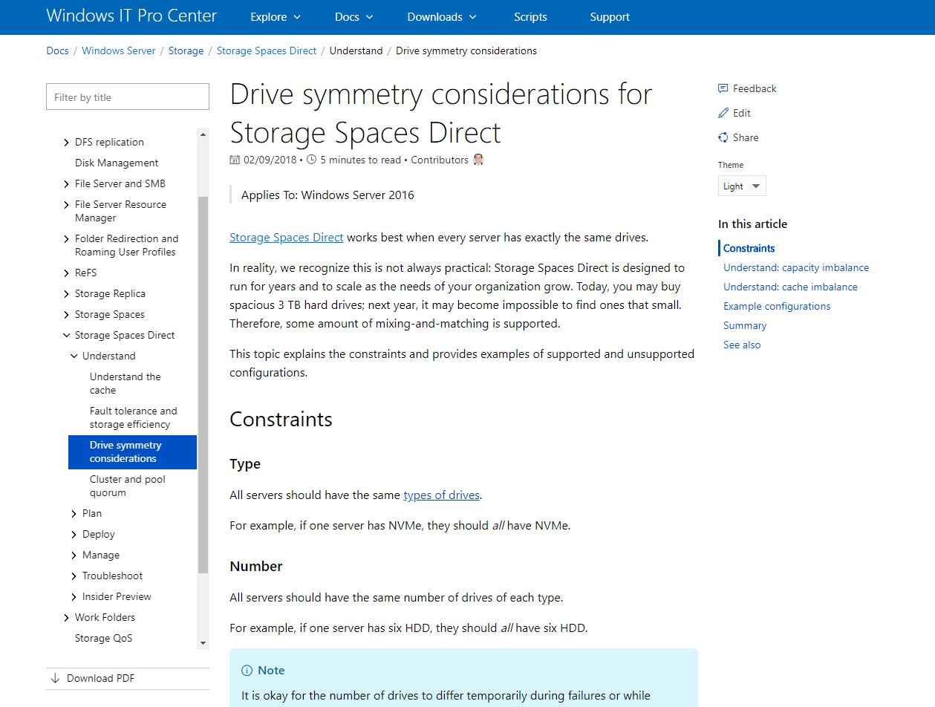
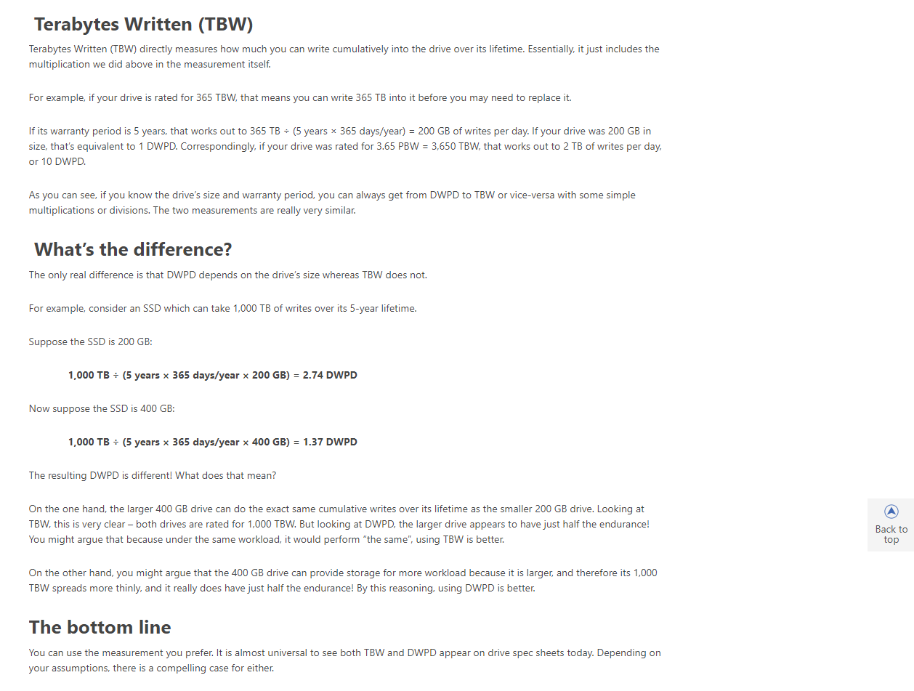
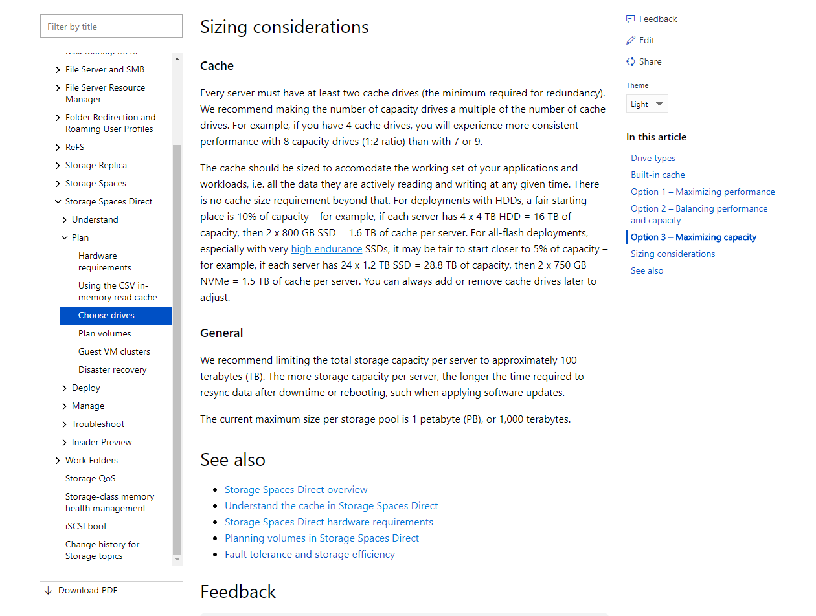
aka.ms/StorageSpacesDirect > Hardware Requirements

Slide 29
– 2 –
For two-node…

Slide 30
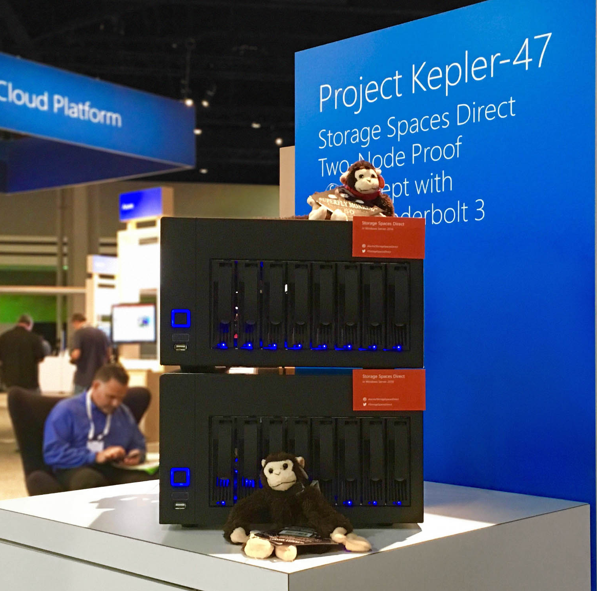
Two servers
Full-featured, cost-effective, surprisingly popular

Slide 31
Quorum without another server or virtual machine, without Internet, and even without Active Directory, for under $5.
introducing TRUE TWO-NODE
USB

Slide 32
Quorum without another server or virtual machine, without Internet, and even without Active Directory, for under $5.
introducing TRUE TWO-NODE
USB

Slide 33
Quorum without another server or virtual machine, without Internet, and even without Active Directory, for under $5.
Windows Server
2019
introducing TRUE TWO-NODE
Applies only to
USB

Slide 34
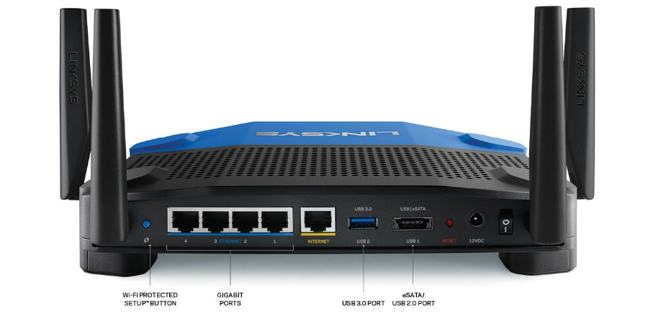
How it works
Router
USB
Uplink
1 GbE
10 GbE
10 GbE
Switchless
10 GbE
Server #1
Server #2
* Image courtesy of Linksys

Slide 35
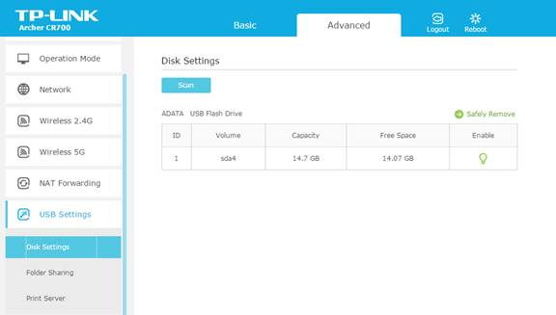
Simple set-up experience
1
2
3
Plug in USB
Share from router
Use as witness
Set-ClusterQuorum
-FileShareWitness \\Server\Share
-Credential $(Get-Credential)
Insert the USB storage device into the port on the router
In the router’s UI, set the share name, username, and password for access
New parameter to provide credentials to Windows for safekeeping

Slide 36
How it works
Router
USB
Uplink
1 GbE
10 GbE
10 GbE
Switchless
10 GbE
Server #1
Server #2

Slide 37
NEW! USB Witness
Windows Server
Applies only to
2019
Extremely low cost
Router
Needed anyway for uplink
Use any router from any major vendor
Need USB and SMB 2+ support
USB storage device
Any size, witness.log is under 1 KB
Pack of 10 for $20 online
Works anywhere
Without
Any other server, unlike File Share Witness
Internet, unlike Cloud Witness
Active Directory
Rugged
Minimal power footprint
No moving parts
Available today in Insider Preview

Slide 38
– 3 –
Nested resiliency

Slide 39
RAID-1 (Two-Way Mirror)
Between Servers
Server 1
Server 2
Data
“A”
Data
“B”
Data
“C”
Data
“D”
Data
“E”
Parity
P₁
Copy
“A”
Copy
“B”
Copy
“C”
Copy
“D”
Copy
“E”
Copy
P₁
RAID-5 (Single Parity) Within Server
RAID-5 (Single Parity) Within Server
“RAID-51 is the RAID level for the truly paranoid, the "belt and suspenders" technique to maximize fault tolerance and availability, at the expense of just about everything else.”
- PC Guide

Slide 40
Nested two-way mirror Effectively, You have four copies
Volume
100% Mirror
LBA 0, 1, 2, 3…
...N
Two-Way Mirror at
StorageScaleUnit level
Two-Way Mirror at
PhysicalDisk level
Two-Way Mirror at
PhysicalDisk level
Data
Copy
Copy
Copy
Server 1
Server 2

Slide 41
Nested mirror- accelerated parity Effectively, Option 1 + RAID-51
Writes
Volume
Mirror
LBA 0, 1, 2, 3…
Parity
...N
Two-Way Mirror
Data
Copy
Node-local
two-way mirror
Copy
Copy
Data
Data
Data
P₁
Node-local
single parity
Copy
Copy
Copy
P₁
Server 1
Server 2

Slide 42
Survive simultaneous failures with just 2 nodes
When any 2 capacity drives are lost,
When 1 server and 1 capacity drive are lost,
When 1 server and 1 cache drive are lost,
Server 1
Server 2
Server 1
Server 2
Server 1
Server 2
Stays online
Stays online
Stays online*
* Upon first failure, the cache will switch to read-only (not read/write) and must drain prior to the second failure

Slide 43
How much usable space do I get?
New!
New!
~25%
Nested two-way mirror
~33%
Normal three-way mirror*
~40%
Nested mirror-accelerated parity**
~50%
Normal two-way mirror
* Requires three nodes ** Depends on the number of capacity drives – more is better, up to 8

Slide 44
– 4 –
Deduplication and compression

Slide 45
Together at last
Windows Server
Applies only to
2019
Resilient File System
Recommend for Storage Spaces
Detect and correct corruptions
Mirror-accelerated parity
Great features for Hyper-V
Faster VHDX creation / expansion
VHDX checkpoint integration
Learn more at aka.ms/refs
Data Deduplication
Highly optimized
Outside of IO path (post-processing)
Variable-size chunk store
Multi-threaded
Highly scalable
Volumes up to 64 TB
Files up to 1 TB
Learn more at aka.ms/dedup
Available today in Insider Preview

Slide 46
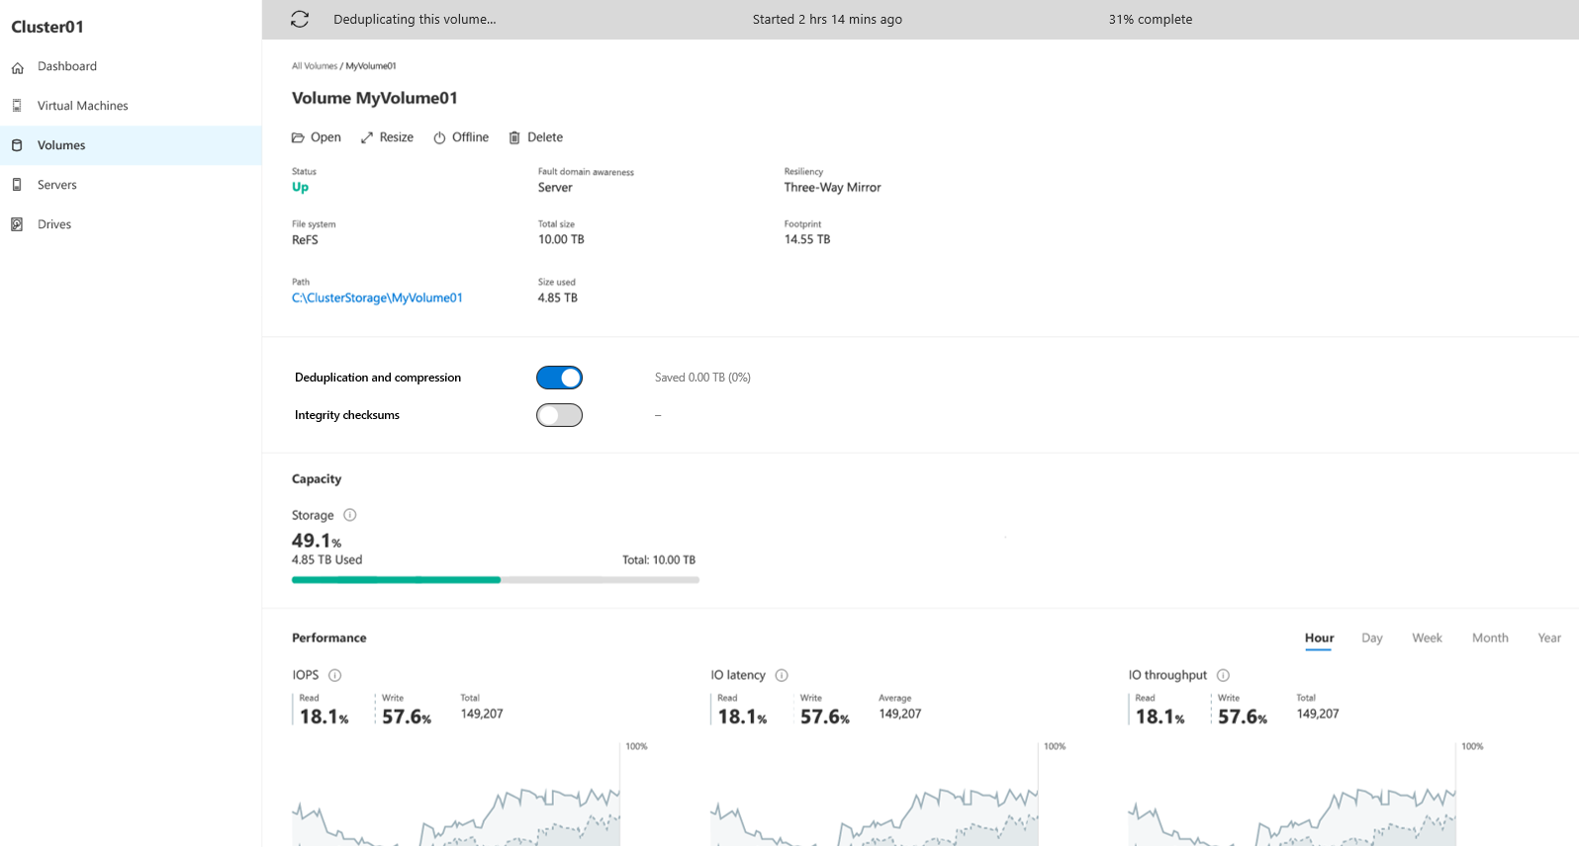
Turn on with one click
Windows Server
Applies only to
2019

Slide 47
Get up to 10X more usable storage for free!
Documents, photos, music, videos
General-purpose file server
Virtual hard disk files, .iso files, backup
30%
Savings
60%
Savings
90%
Savings

Slide 48
– 5 –
Scale up, up, and away!

Slide 49
Max scale?
1 petabyte (PB) = 1,000 terabytes (TB)

Slide 50
1 PB
Windows Server 2016
1 petabyte (PB) = 1,000 terabytes (TB)

Slide 51
1 PB
Windows Server 2016
4 PB
Windows Server 2019
1 petabyte (PB) = 1,000 terabytes (TB)

Slide 52
NEW! Larger maximum scale
Windows Server
Applies only to
2019
Limit / Recommendation | Windows Server 2016 | Windows Server 2019 | Increase
Max servers per cluster | 16 | 16 | -
Max drives per cluster | 416 | 416 | -
Max raw capacity per cluster | 1 PB | 4 PB | 4x
Max raw capacity per server | 100 TB | 400 TB | 4x
Max number of volumes | 32 | 64 | 2x
Max size per volume | 32 TB | 64 TB | 2x

Slide 53
– 6 –
Persistent memory

Slide 54
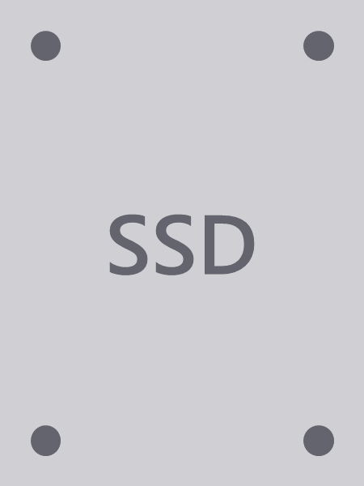
Types of drives
PMEM
Persistent Memory
NVDIMM-N, Intel Optane DIMMs
Non-Volatile Memory Express
Connected via PCIe, includes M.2, U.2, Add-In-Card, and Intel Optane (3D X-Point)
Solid-State Drive
Any SSD connected via SATA or SAS, must have power-loss protection (PLP)
Hard Disk Drive
Any HDD connected via SATA or SAS, can be any RPM

Slide 55
Types of drives
PMEM
Persistent Memory
NVDIMM-N, Intel Optane DIMMs
Non-Volatile Memory Express
Connected via PCIe, includes M.2, U.2, Add-In-Card, and Intel Optane (3D X-Point)
Solid-State Drive
Any SSD connected via SATA or SAS, must have power-loss protection (PLP)
Hard Disk Drive
Any HDD connected via SATA or SAS, can be any RPM
~ 5 µs
~ 0.1 ms
~ 0.1 ms
~ 10 ms
5,000 ns
100,000 ns
100,000 ns
10,000,000 ns

Slide 56
Types of drives
PMEM
~ 10 µs
~ 0.1 ms
~ 0.1 ms
~ 10 ms
5,000 ns
100,000 ns
100,000 ns
10,000,000 ns

Slide 57
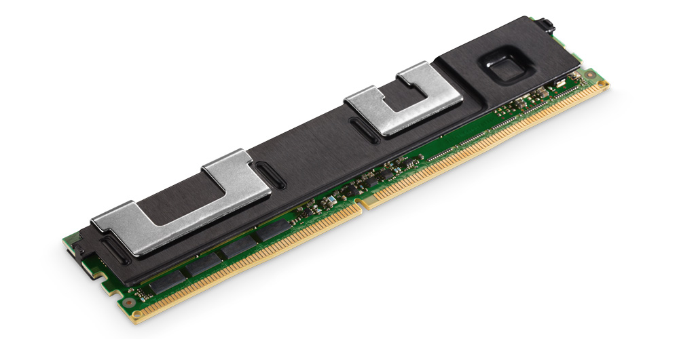
Persistent memory
* Image courtesy of Intel

Slide 58
Persistent memory
Windows Server
2019
Applies only to
Full support with Storage Spaces Direct
Use as cache
Accelerate active working set
Use as capacity
Extremely consistent, low latency
Simple and familiar user experience
“Just another physical disk”
With new MediaType
Use PowerShell or Windows Admin Center
* Image courtesy of Intel

Slide 59
– 7 –
Faster mirror-accelerated parity

Slide 60
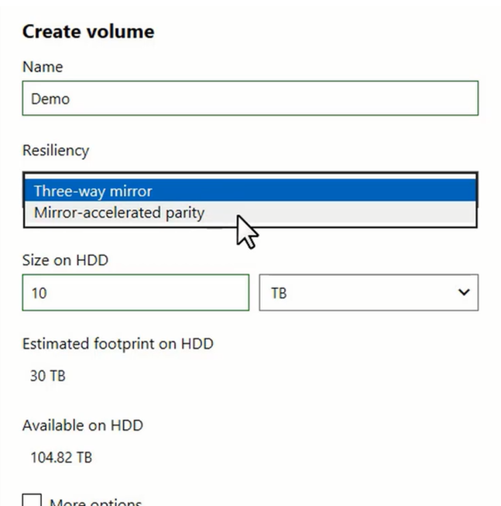
Mirror-accelerated parity
Windows Server
Windows Server
2016
2019
Applies to both versions
Create volume that’s part mirror, part parity
Write to mirror, “rotate” to parity later
Defer compute-intensive calculation to nearline
Strike the right balance
You choose the ratio of mirror-to-parity
Tradeoff performance for storage efficiency

Slide 61
Mirror-accelerated parity gives capacity back
Mirror/Parity Ratio | Mirror Overhead | Parity Overhead | Example Size | Example Footprint
100% mirror | 3x | 2x (RS 2+2) | 10 TB | 30 TB
30% mirror, 70% parity | 3x | 2x (RS 2+2) | 10 TB | 23 TB
20% mirror, 80% parity | 3x | 2x (RS 2+2) | 10 TB | 22 TB
10% mirror, 90% parity | 3x | 2x (RS 2+2) | 10 TB | 21 TB
4 nodes
Mirror/Parity Ratio | Mirror Overhead | Parity Overhead | Example Size | Example Footprint
100% mirror | 3x | 1.5x (RS 4+2) | 10 TB | 30 TB
30% mirror, 70% parity | 3x | 1.5x (RS 4+2) | 10 TB | 19.5 TB
20% mirror, 80% parity | 3x | 1.5x (RS 4+2) | 10 TB | 18 TB
10% mirror, 90% parity | 3x | 1.5x (RS 4+2) | 10 TB | 16.5 TB
8 nodes
Mirror/Parity Ratio | Mirror Overhead | Parity Overhead | Example Size | Example Footprint
100% mirror | 3x | 1.375x (LRC 8,2,1) | 10 TB | 30 TB
30% mirror, 70% parity | 3x | 1.375x (LRC 8,2,1) | 10 TB | 18.625 TB
20% mirror, 80% parity | 3x | 1.375x (LRC 8,2,1) | 10 TB | 17 TB
10% mirror, 90% parity | 3x | 1.375x (LRC 8,2,1) | 10 TB | 15.375 TB
12 nodes
2x

Slide 62
Baseline
Windows Server 2016
Measured with 4K random IO, drifting working set, and 70/30 read/write mix

Slide 63
Baseline
Windows Server 2016
+100%
Windows Server 2019
Measured with 4K random IO, drifting working set, and 70/30 read/write mix

Slide 64
NEW! 100% Faster mirror-accelerated parity
Windows Server
2019
Applies only to
Storage performance in IOPS
Three-way mirror
Mirror-accelerated parity
+100%
Dual parity
* Mirror-accelerated parity outperforms dual parity, especially in Windows Server 2019, but three-way mirror remains the clear performance leader.
Capacity efficiency in %
Three-way mirror
Mirror-accelerated parity
Dual parity
* Three-way mirror has 33.3% storage efficiency. Dual parity starts at 50.0% and goes up to 80.0%. Mirror-accelerated parity is in between.

Slide 65
– 8 –
Built-in performance history

Slide 66
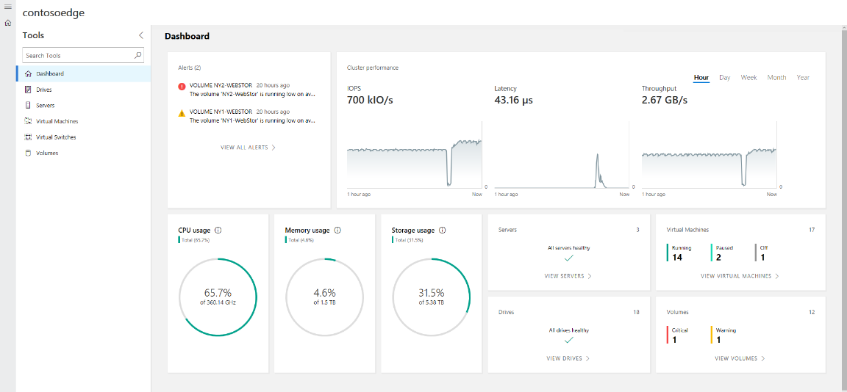

Slide 67
You do not need to install, configure, or start anything. An external database is not required.
An Internet connection is not required.
System Center is not required.

Slide 68
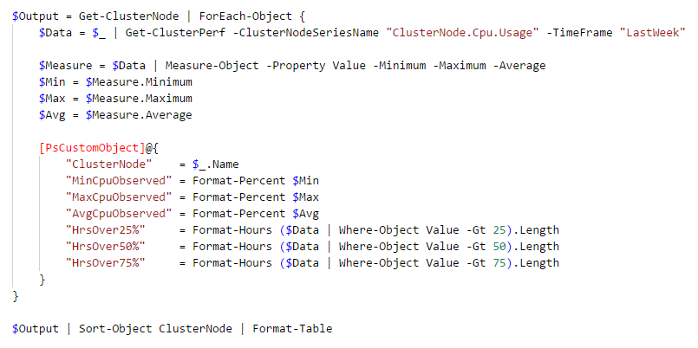
Were there any CPU spikes last week?

Slide 69
Were there any CPU spikes last week?

Slide 70
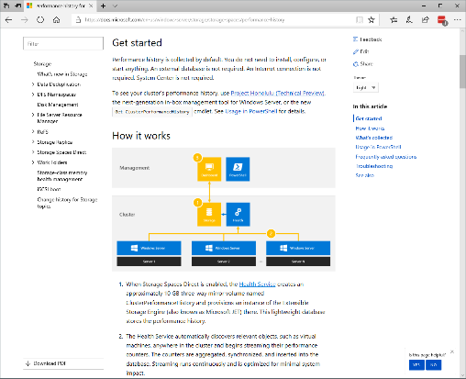
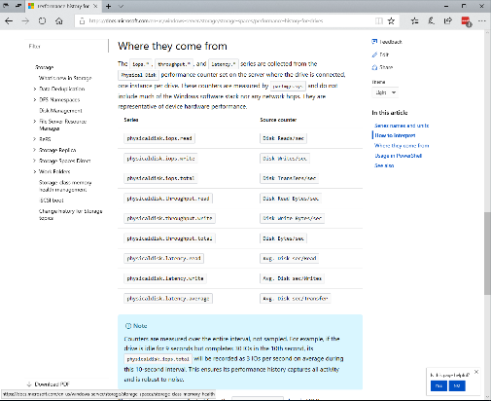
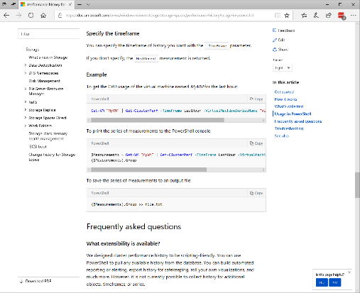
aka.ms/ClusterPerformanceHistory

Slide 71
– 9 –
Built-in outlier detection

Slide 73
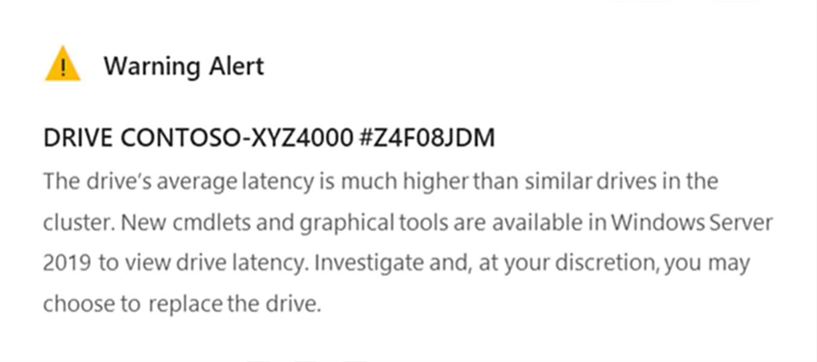
NEW! Proactive outlier detection
Windows Server
2019
Applies only to
Continuously monitor drive latency
Organize drives into peer groups
Compare every drive’s mean latency against its peers
Compare every drive’s tail (99th percentile) latency against its peers
Proven in Azure
Long-standing and very successful approach

Slide 74
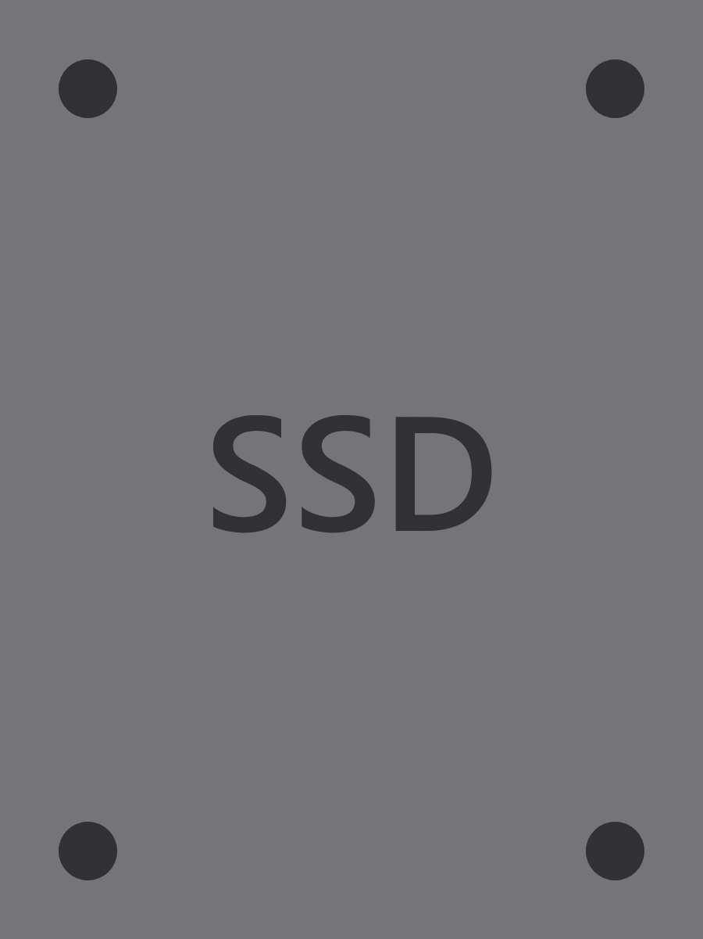
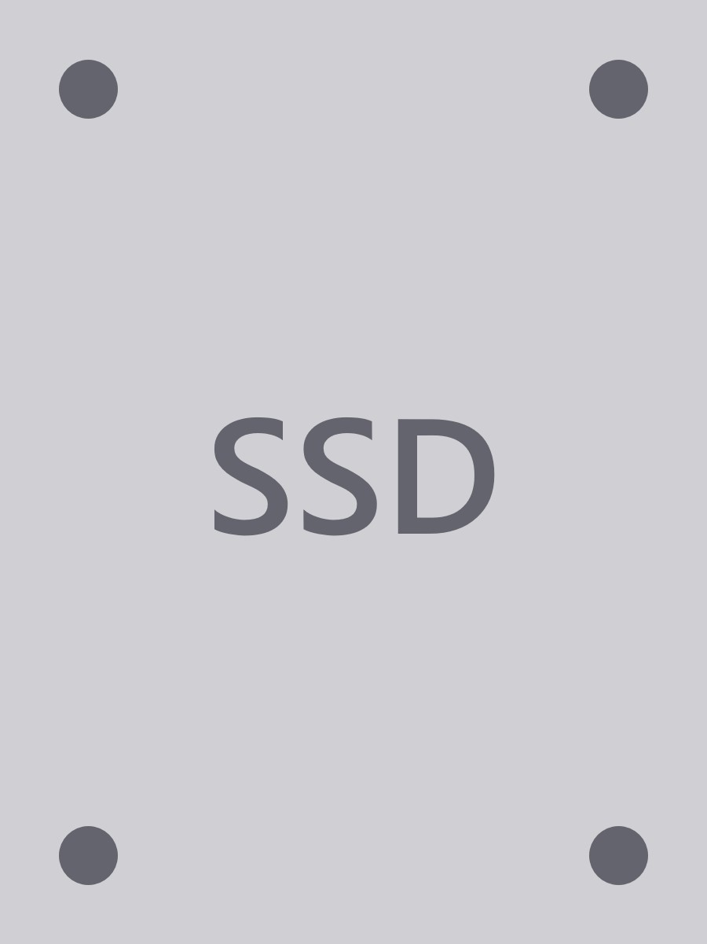

Slide 75
(6) Group A
(5) Group B
(17) Group C
Group by media and usage

Slide 76
Latency
(6) Group A
(5) Group B
(17) Group C
Variety of analyses, including rolling average and tail latency

Slide 77
Latency
(6) Group A
(5) Group B
(17) Group C
Azure-inspired outlier detection algorithm

Slide 78
– 10 –
Simpler PowerShell

Slide 79
Clear-ClusterNode -CleanUpDisks
Wipe drives to start over
New-Volume -FriendlyName Example -Size 100GB
Provision
Get-SddcDiagnosticInfo
Gather every relevant log

Slide 80
https://docs.microsoft.com/en-us/windows-server/storage/storage-spaces/data-collection
Update from PowerShell Gallery or GitHub
Tip: Use Import-Clixml to read xml files:
PS C:\temp\HealthTest> Import-Clixml -Path .\WM_ClusPort.xml | ? deviceattribute -eq 1312 | ft ConnectedNode, DeviceGuid
ConnectedNode DeviceGuid
------------- ----------
YS0009UK {da56b3f8-2e04-60be-2880-76596938d165}
YS0009UK {36aa9ccc-941d-6ca0-6a3b-7ad17dd421a5}
YS0009UK {8cd0801c-f79f-bc29-349b-0dee7232c6ca}
Get-SddcDiagnosticInfo
Gather every relevant log

Slide 81
Relaxed hardware requirements
USB witness for two-node at the edge
Nested resiliency (RAID-51) for two-node
Deduplication and compression
Scale up to 4 PB
Full support for persistent memory
Mirror-accelerated parity is 100% faster
Built-in performance history
Built-in outlier detection
Simpler PowerShell
What’s New
for Storage Spaces Direct

Slide 82
Learn more at
aka.ms/StorageSpacesDirect

Slide 83
Learn more at
aka.ms/SpacesDirect

Slide 84
Learn more at
aka.ms/s2d

Slide 85
Hands-on-Lab Windows Admin Center

Slide 86
Hyper-Converged Infrastructure Market Opportunity
Storage Spaces Direct 10 Ways It’s Better in WS 2019
Software Defined Networking Network Controller and Gateway
RDMA
Cluster Sets Scaling Out
Agenda

Slide 87
Hyper-Converged Infrastructure Market Opportunity
Storage Spaces Direct 10 Ways It’s Better in WS 2019
Software Defined Networking Network Controller and Gateway
RDMA
Cluster Sets Scaling out
Agenda

Slide 88
Scale AND Resiliency
Cluster 1
Cluster 2
Cluster 4
Cluster 3

Slide 89
Hyperscale for Hyper-converged
Cluster Set Head
Centralized Cluster Set Management
Unified Namespace \\ClusterSet\Share1
Cluster 1
Cluster 2
Cluster 3
Cluster 4

Slide 90
Hyperscale for Hyper-converged
Loosely couples a grouping of multiple clusters (think clustering clusters)
Cluster Set Head
Centralized Cluster Set Management
Unified Namespace \\ClusterSet\Share1
Cluster 1
Cluster 2
Cluster 3
Cluster 4

Slide 91
Hyperscale for Hyper-converged
Loosely couples a grouping of multiple clusters (think clustering clusters)
Increases cluster nodes and storage
Cluster Set Head
Centralized Cluster Set Management
Unified Namespace \\ClusterSet\Share1
Cluster 1
Cluster 2
Cluster 3
Cluster 4

Slide 92
Hyperscale for Hyper-converged
Loosely couples a grouping of multiple clusters (think clustering clusters)
Increases cluster nodes and storage
Utilizes a self-managed namespace
Cluster Set Head
Centralized Cluster Set Management
Unified Namespace \\ClusterSet\Share1
Cluster 1
Cluster 2
Cluster 3
Cluster 4

Slide 93
Hyperscale for Hyper-converged
Loosely couples a grouping of multiple clusters (think clustering clusters)
Increases cluster nodes and storage
Utilizes a self-managed namespace
Have your scale and keep your resiliency too
Cluster Set Head
Centralized Cluster Set Management
Unified Namespace \\ClusterSet\Share1
Cluster 1
Cluster 2
Cluster 3
Cluster 4

Slide 94
What does Cluster Sets do?
Cluster Set Head
Centralized Cluster Set Management
Unified Namespace \\ClusterSet\Share1
Cluster 1
Cluster 2
Cluster 3
Cluster 4

Slide 95
What does Cluster Sets do?
Allows for virtual machine fluidity
Cluster Set Head
Centralized Cluster Set Management
Unified Namespace \\ClusterSet\Share1
Cluster 1
Cluster 2
Cluster 3
Cluster 4

Slide 96
What does Cluster Sets do?
Allows for virtual machine fluidity
Places new virtual machines on an optimal node
Cluster Set Head
Centralized Cluster Set Management
Unified Namespace \\ClusterSet\Share1
Cluster 1
Cluster 2
Cluster 3
Cluster 4

Slide 97
What does Cluster Sets do?
Allows for virtual machine fluidity
Places new virtual machines on an optimal node
Allows movement of the VMs between clusters without changing storage paths
Cluster Set Head
Centralized Cluster Set Management
Unified Namespace \\ClusterSet\Share1
Cluster 1
Cluster 2
Cluster 3
Cluster 4

Slide 98
What does Cluster Sets do?
Allows for virtual machine fluidity
Places new virtual machines on an optimal node
Allows movement of the VMs between clusters without changing storage paths
Takes advantage of a new role “Infrastructure Scale Out File Server”
Cluster Set Head
Centralized Cluster Set Management
Unified Namespace \\ClusterSet\Share1
Cluster 1
Cluster 2
Cluster 3
Cluster 4

Slide 99
What does Cluster Sets do?
Allows for virtual machine fluidity
Places new virtual machines on an optimal node
Allows movement of the VMs between clusters without changing storage paths
Takes advantage of a new role “Infrastructure Scale Out File Server”
Takes advantage of the new SMB feature “SMB Loopback”
Cluster Set Head
Centralized Cluster Set Management
Unified Namespace \\ClusterSet\Share1
Cluster 1
Cluster 2
Cluster 3
Cluster 4

